Slide 1

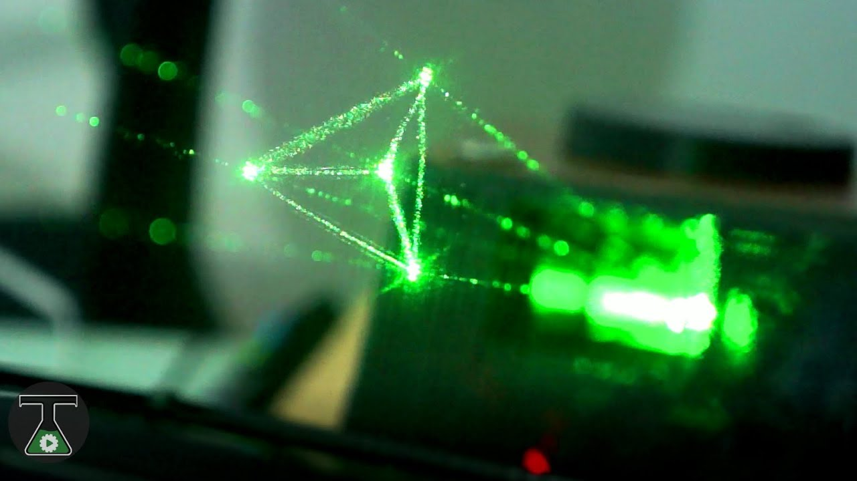
HOLOGRAPHIC TECHNOLOGIES
BY
JAYAPRIYA J
NANTHINI K
MYTHILY S
KONGU ENGINEERING COLLEGE

Slide 2
CONTENTS
INTRODUCTION
WORKING OF HOLOGRAM
APPLICATIONS OF HOLOGRAM
HOLOGRAPHIC INTERFEROMETRIC
ADVANTAGES OF HOLOGRAM
DISADVANTAGES OF HOLOGRAM
CONCLUSION

Slide 3
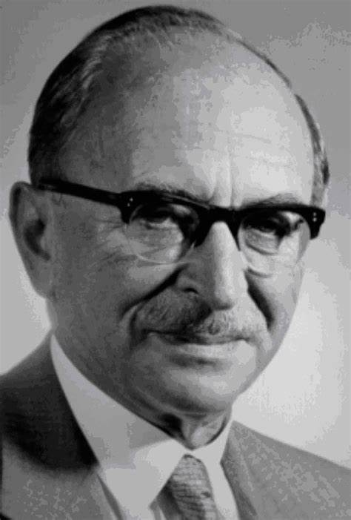
INTRODUCTION DENNIS GABOR-Father of hologram and holographic technologies
HOLOGRAM
‘HOLO’-whole or entirely
‘GRAM’-message or recording
Physical structure that diffracts light into an image
HOLOGRAPHY
Holography is a technique used to create holograms

Slide 4
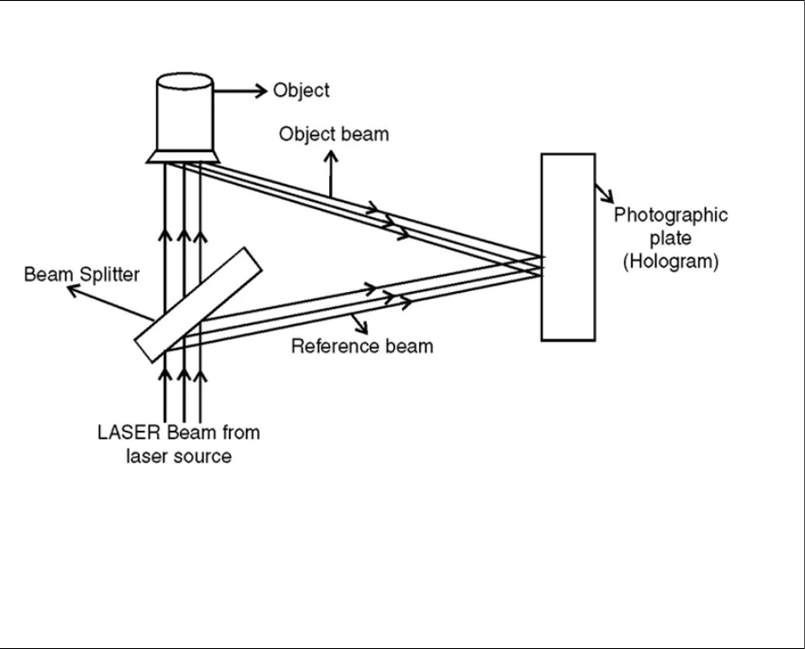
WORKING OF HOLOGRAM
The holography consists of two processes
Recording of hologram
Reconstruction of image
RECORDING OF HOLOGRAM
It is based on the phenomenon of interference
Beam splitter split the laser beam
One part of the splitted beam is called reference beam and the other is called object beam.

Slide 5
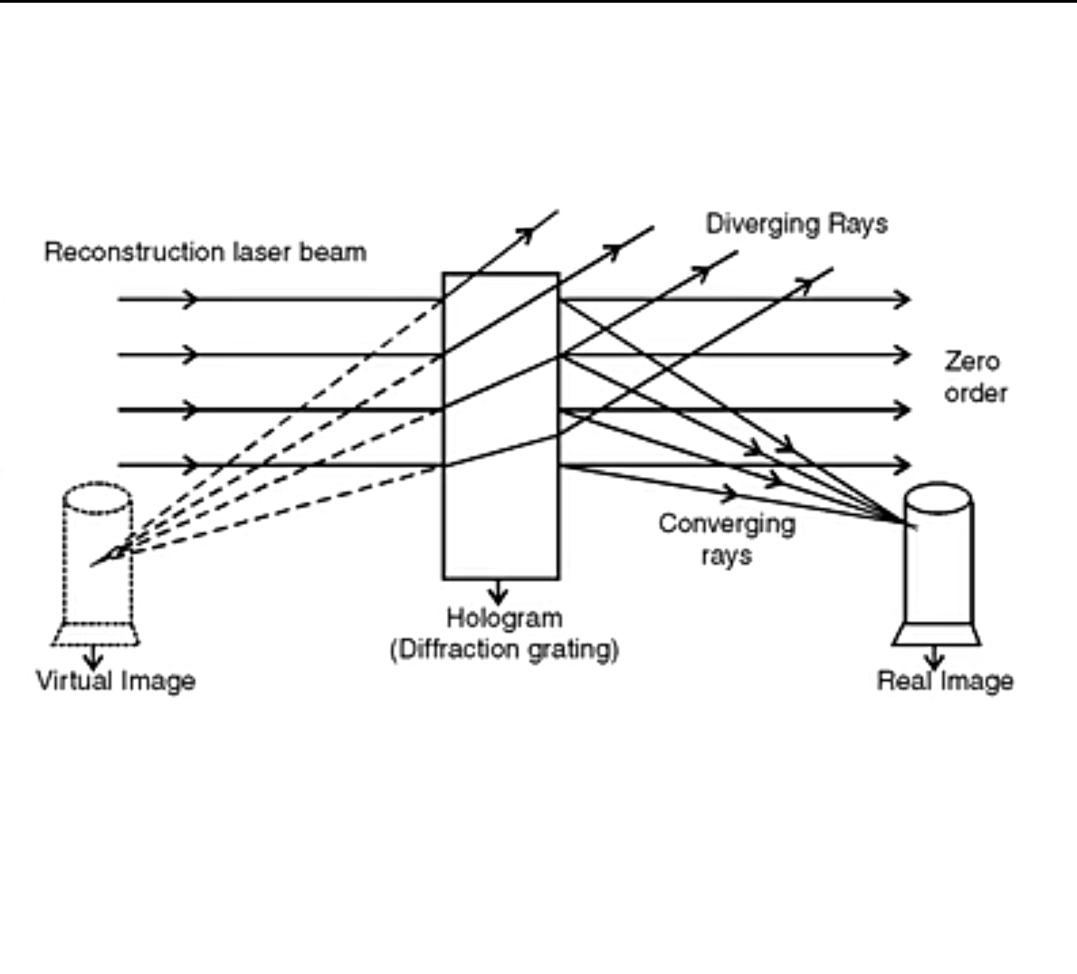
RECONSTRUCTION OF IMAGE
Based on the principle of diffraction
Hologram illuminated by the laser beam is called reconstruction beam
Hologram acts as diffraction grating
Real image is recorded on the photographic plate

Slide 6
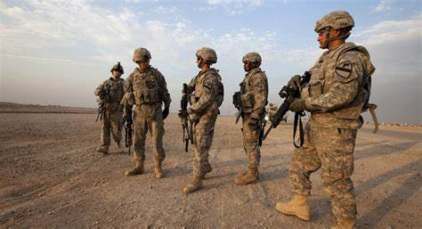
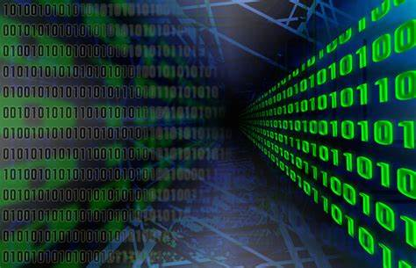
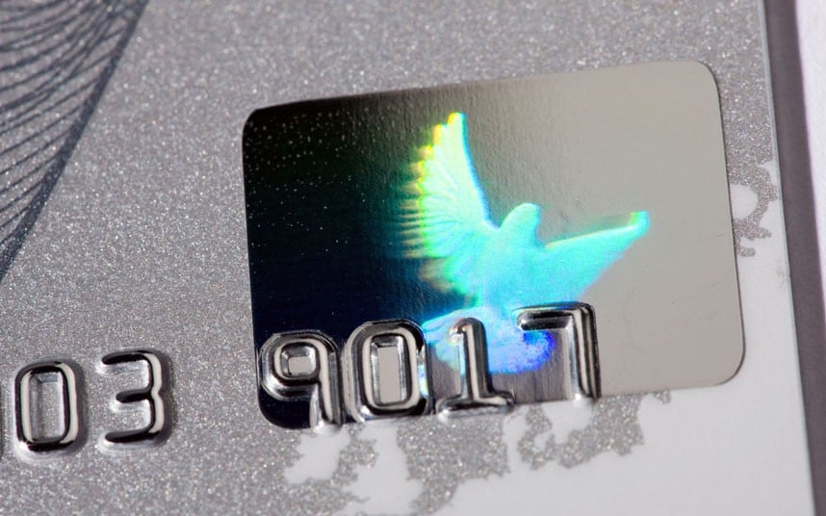
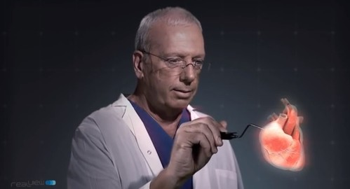
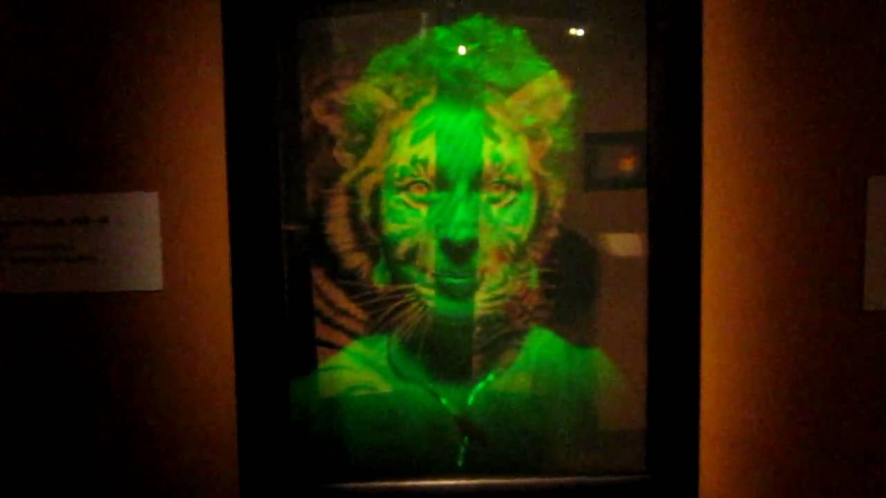
APPLICATIONS OF HOLOGRAM
MILITARY MAPPING
INFORMATION STORAGE
SECURITY
MEDICAL DOMAIN
DOMAIN OF ART

Slide 7
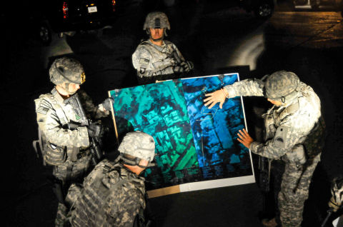
MILITARY MAPPING
Three dimensional holographic maps for the geographical intelligence in military
13,000 3D holographic maps of “battle-spaces”
Easy storage and transportation
Useful in disaster evacuation and rescue scenario

Slide 8
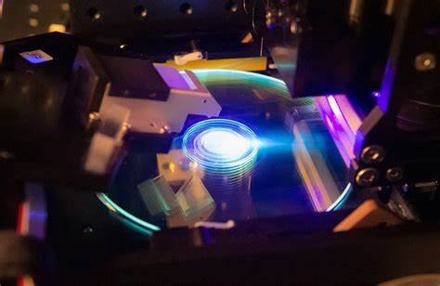
INFORMATION STORAGE
Recording process stores all information
Stores massive amount of information
Optical hologram can reconstruct the data from any of the pieces
Data storage for over 50 years

Slide 9
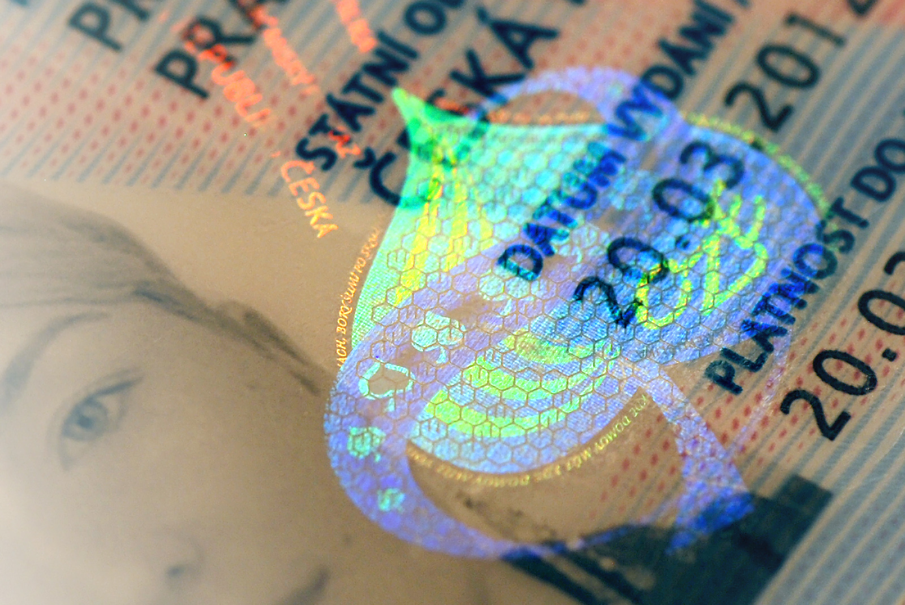
SECURITY
Labels with hologram printed for safe security reasons
Widely in several bank notes
Incredible advantage in the commercial security market
Silver rectangle of dove

Slide 10

MEDICAL DOMAIN
Visualising patient data
Produce computer-generated 3d holographic images
Used for training students and surgeons
Storing several different images in the same hologram
Bio-medical applications such as
X-ray and endoscopic holography

Slide 11
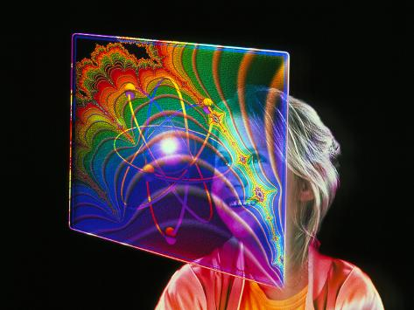
DOMAIN OF ART
3D recording opportunities of holograms is used to
Bend and cut space
Construct multiple, visually solids, objects in the same volume
Combine collections of still images or videos to produce animated 3d works
To sculpt pure light

Slide 12
HOLOGRAPHIC INTERFEROMETRIC
It is a way to perform interferometric measurement
Way to trace changes in objects
At least one of the waves is reconstructed by an hologram
Examples:
Non-destructive testing
Analysis of vibrating surfaces
Holographic contouring of objects

Slide 13
ADVANTAGES OF HOLOGRAM
It is cost effective
Higher storage capacity
Increased feasibility of objects
Ability to combine with other technologies
DISADVANTAGES OF HOLOGRAM
Not easily use under florescent lighting
Requires more lighting
Applications to products is costly
Time consuming when it comes to constructing images

Slide 14
CONCLUSION
Phase information of the light is recorded by utilizing the interference phenomenon
Breakthrough on laser technology lead to the rapid development of holography
The applications are changing lives, saving lives and stimulating creative and intellectual discussion
ANY QUERIES?

